Slide 1
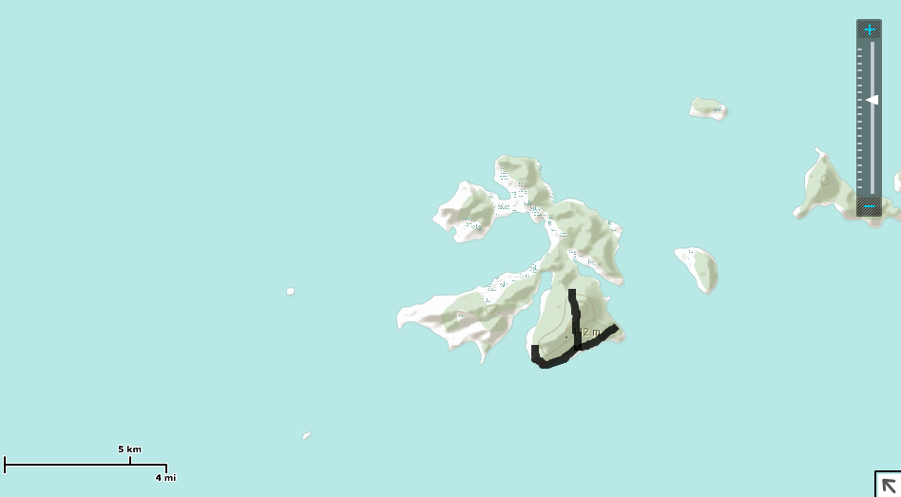
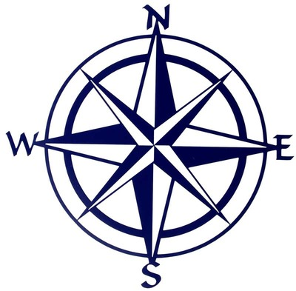
Cave
Mountain
Jungle
Palm Tree
Shack
Ocean

